Slide 1
The best location for an ice-cream shop in Manhattan
Capstone Project - IBM

Slide 2
Data Source
Data set with all the boroughs and the neighborhoods in NY: https://geo.nyu.edu/catalog/nyu_2451_34572
Foursquare database

Slide 3
Methodology
As the ice-cream shop must be located in a tourist area, the first, second or third most common venue in the neighborhood must be a hotel.
The neighborhood should not contain an ice-cream shop among the most common venues.
The ice-cream shop should be located in an area full of restaurants, bistros and cafes. That is, of the 10 most common venues, at least 6 must fall in the following categories: Restaurants, sandwich place, steakhouse, coffee shops, bakery, cafés and bistros.

Slide 4
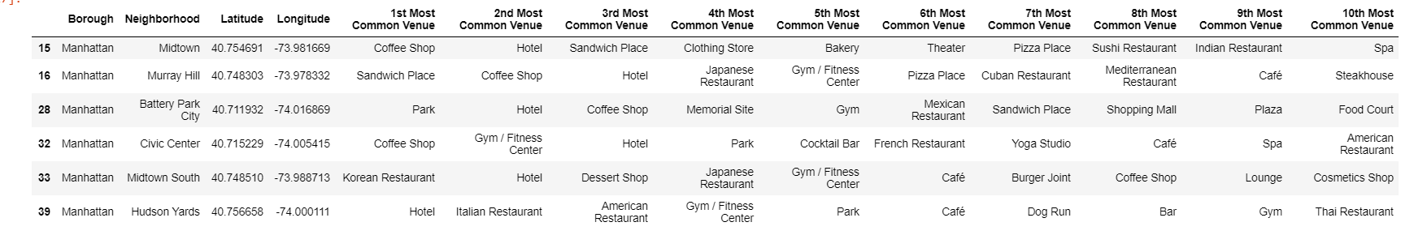
Results
First Criteria: the first, second or third most common venue in the neighborhood must be a hotel.
6 possible neighborhoods

Slide 5
Results
Second Criteria: The neighborhood should not contain an ice-cream shop among the most common venues.
6 possible neighborhoods

Slide 6
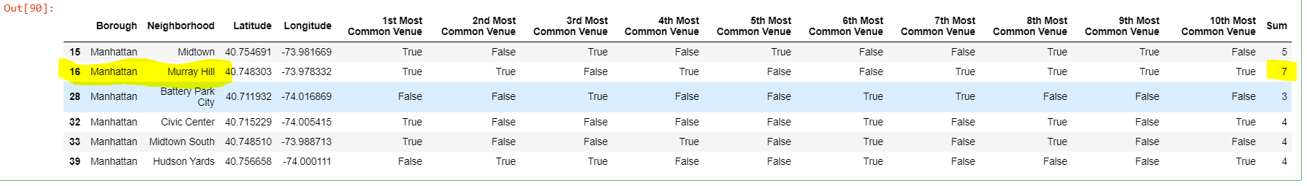
Results
Third Criteria: Of the 10 most common venues, at least 6 must be: Restaurants, sandwich place, steakhouse, coffee shops, bakery, cafés or bistros.
1 possible neighborhood – Murray Hill

Slide 7
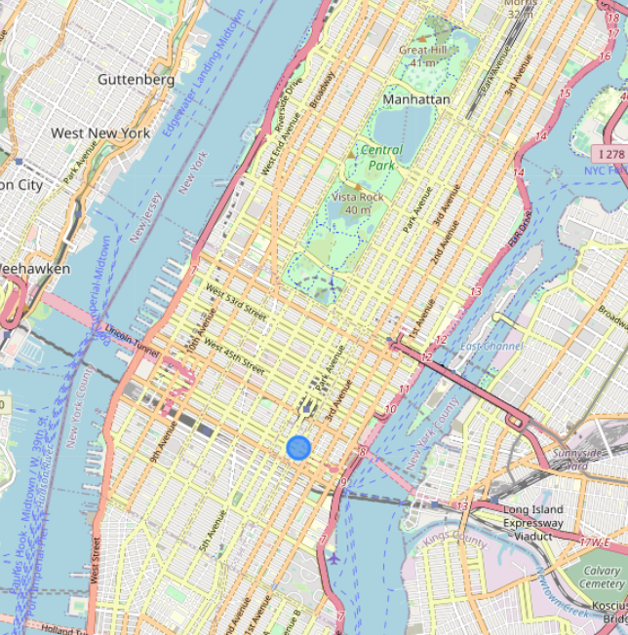
Conclusion
Very central location, in a walking distance to the Times Square and Central Park and full of restaurants, cafés , etc.
In terms of location, Murray Hill is the best place to a new ice-cream shop according to the methodology of this study.

